Slide 1

Attrition analysis A case study
Team Members-
Anugraha Sinha
Ranjidha Rajan
Soumadiptya Chakraborty
Nihar Behera

Slide 2
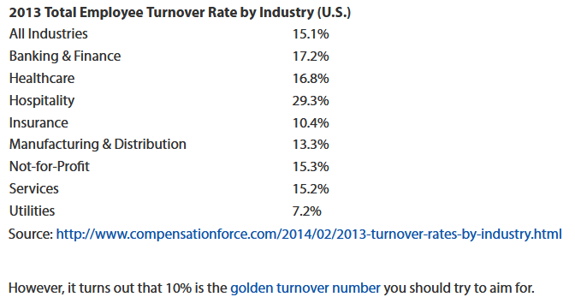
The Problem Statement
Some statistics on XYZ company
Current Workforce strength- 4000
Each year nearly 15% of employees leave the company
This attrition rate is much higher than the ideal turnover rate of ~10%.
Problems created by a High Attrition rate
Delay in Projects making it difficult to meet timelines resulting in a reputation loss among customers and partners
Maintenance cost behind large department for recruiting new talent
Training new employees incurs additional costs
Time involved in acclimatizing for new employees and getting used to company culture leads to further delays in meeting timelines.

Slide 3

Goals and Methodology
Our Problem solving methodology:-
Model Probability of Attrition using a Logistic Regression model
Figure out the most important variables from the Model
Use the variables and their co-efficients to infer how they are related to the Attrition rate.
Suggest how to curb the Attrition rate based on the findings.
Management of XYZ company have contracted our firm to figure out
Most important factors responsible for Attrition
Provide suggestions to reduce the Attrition rate
Pinpoint and make changes to their workplace to get most employees to stay

Slide 4


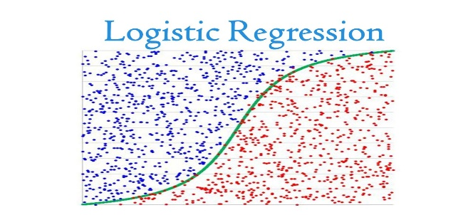
Data Analysis Methodology
General Employee Data
Employee Satisfaction data
Manager Survey Data
Employee in-time data
Employee out time data
Combined Source dataset
Missing value Treatment
Build the initial model
Use step AIC to reduce variables
Repeatedly iterate on p-values and VIF till only significant variables are left
Use model to make predictions on training data
Calculate model performance on testing data and re-build model if needed
Derived Metric creation from in time and out time data
Outlier Treatment
Scaling of variable values
Split into train and test data

Slide 5
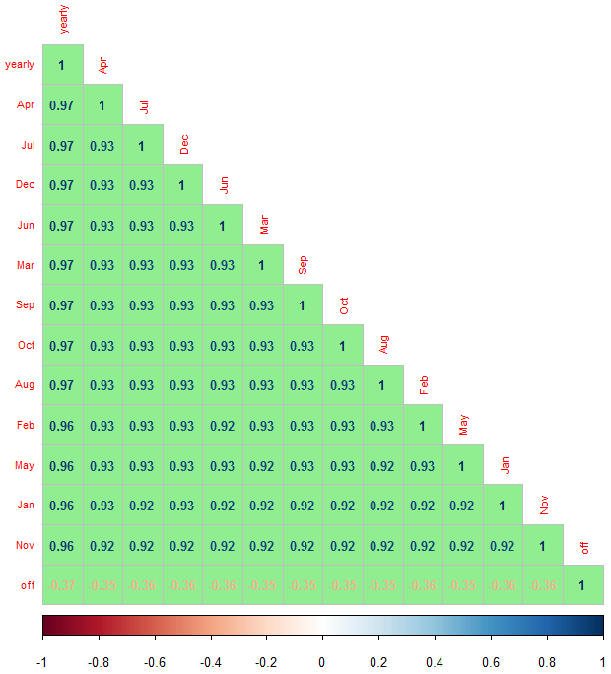
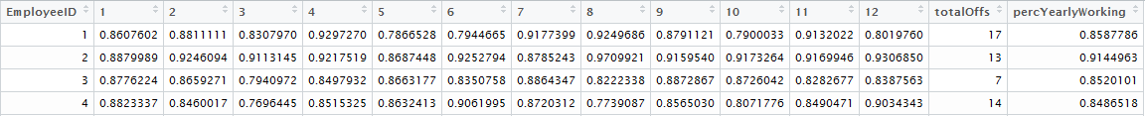
Data Sourcing and Cleaning – Part 1
Working on in_time and out_time data.
Total columns : 250 (249 days + 1 Employee ID)
Total rows : 4410
Number of columns with all NAs (holidays) : 12 days
Data processing :
For every employee build a monthly (percentage) working hours.
For every employee build a total number of yearly offs
For every employee build a yearly (percentage) working hours
Build a correlation between different columns to see if monthly data for each employee helps in build some significant figures.
Conclusion:
Monthly data for employees are highly correlated
Yearly percentage working hours is a good figure for reflecting on pattern.
Yearly Offs is also a good metric for reflecting employee patterns.
Note:
Rather than taking mean as a metric for measuring this pattern, percentage has been chosen as a more viable metric as comparison by percentage is more absolute in data reflection in this case.

Slide 6

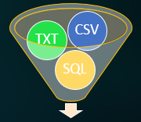
Data Sourcing and Cleaning – Part 2
Data Understanding
Employee survey (3 features) : Survey of employee satisfaction on different
parameters
Manager survey (2 features) : Employee opinion of managers
In time and out time data (Daily) : Employee’s in-time and out-time data
(Period : 12 months)
General Data (24 features) : Various information about employees, department, Job Role etc.
Primary key linking all data : Employee ID (Total employee list – 4410 employees)
Strategy | Remarks | Execution and Results | Number of columns found
Single Value Type Columns | Columns where count of unique values = 1 | Remove columns which match strategy | EmployeeCount, Over18, Standard Hours
Columns with only 0s and NAs | Columns where count of unique value = 2 and it is only 0s and NAs | Remove columns which match strategy | Some dates (which are holidays) have in_time, out_time as NA. "2015.01.01" "2015.01.14" "2015.01.26" "2015.03.05" "2015.05.01" "2015.07.17" "2015.09.17" "2015.10.02" "2015.11.09" "2015.11.10“ "2015.11.11" "2015.12.25"
NA treatment | TotalWorkingYears – Impute value based on currentAge minus the mean age when people start working. | Mean age of people when they start working = 26 years | 1 column updated
 | NumCompaniesWorked , EnvironmentSatisfaction, JobSatisfaction, WorkLifeBalance No relationship/pattern found with other columns. Removed rows which have NA. | AttritionYes removed = 2.0% AttritionNo Removed = 2.3% Total rows removed = 102 rows ~ 2.3% | 4 column updated
Final dimensions for data of all employees will all columns merged = 4308 x 28

Slide 7
Feature Classification – Numerical/Categorical
Categorical Features
Numerical Features
S.No | Feature Name | Remarks
1 | Attrition | Possible values = Yes/No
2 | BusinessTravel | Possible values = Non-Travel, Travel_Frequently, Travel_Rarely
3 | Department | Possible values = Human Resources, Research & Development, Sales
4 | EducationField | Possible values = Human Resources, Life Sciences, Marketing, Medical, Other, Technical Degree
5 | Gender | Possible values = Female, Male
6 | JobRole | Possible values = Healthcare Representative, Human Resources, Laboratory Technician, Manager, Manufacturing Director, Research Director, Research Scientist, Sales Executive, Sales Representative
7 | MaritalStatus | Possible values = Divorced, Married, Single
8 | StockOptionLevel | Possible values = 0, 1, 2, 3
S.No | Feature Name | Remarks
1 | totalOffs, percYearlyWorking, Age, DistanceFromHome | Numeric/continuous values
2 | Education | Ordered Categorical – higher number means better education (1 – belowCollege, 5 – Doctor/PhD)
3 | JobLevel | Ordered Categorical – higher number means better higher employee band
4 | MonthlyIncome, NumCompaniesWorked PercentSalaryHike TotalWorkingYears TrainingTimesLastYear YearsAtCompany YearsSinceLastPromot YearsWithCurrManager | Numerical/continuous values
5 | EnvironmentalSatisfaction JobSatisfaction WorkLifeBalance JobInvolvement PercformanceRating | Ordered Categorical

Slide 8
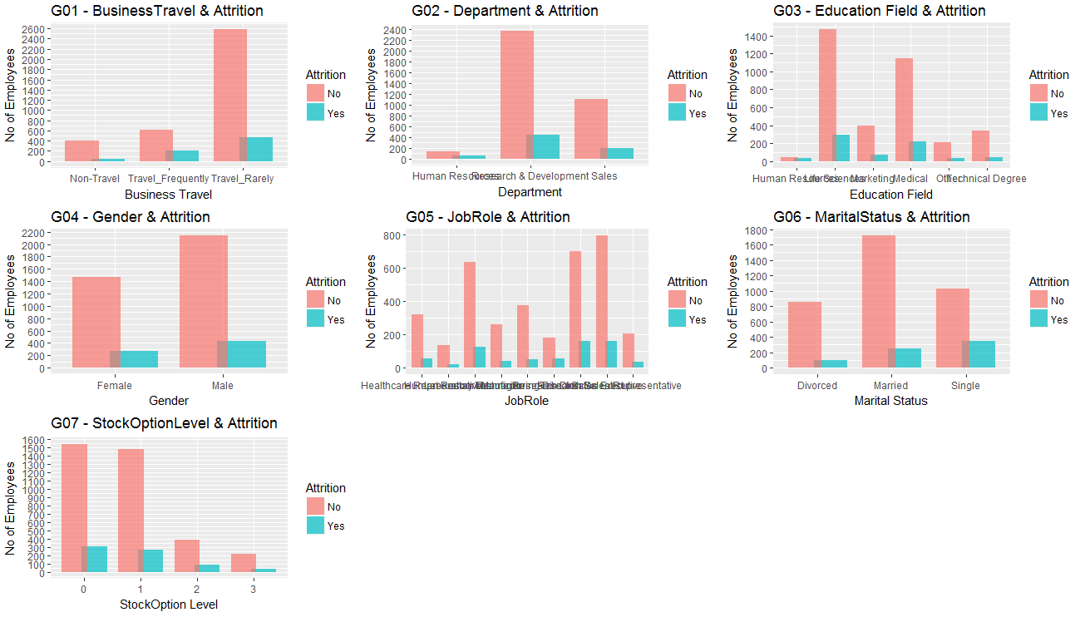
Univariate & Segmented Univariate – Categorical Features
Analysis (1/4)
Inference :
G(01) – Business Travel
Frequent Business Travel has a higher percentage of Attrition (~ 25%).
G(02) - Department
The HR department in itself has a high Attrition rate (~29%). HR is a small department (187 employees) out of which 55 left during the last year.
G(03) – Education Field
As reflected in the Department category, Human Resource education field is prone to highest attrition (~40%)
G(04) – Gender & G(05) – Marital Status
Attrition among Males/Females seem to be balanced. Where as “Single” employees, have a high Attrition rate (~25%)
G(06) - JobRole
Across different Job Roles, the attrition hovers around company average level, except Research Director Role (~23%).
G(07) - StockOption
Attrition rate is same across different stockOptions levels.
Plot Methodology : Segmented Column plots
Aggregation : Various (as per plot)

Slide 9
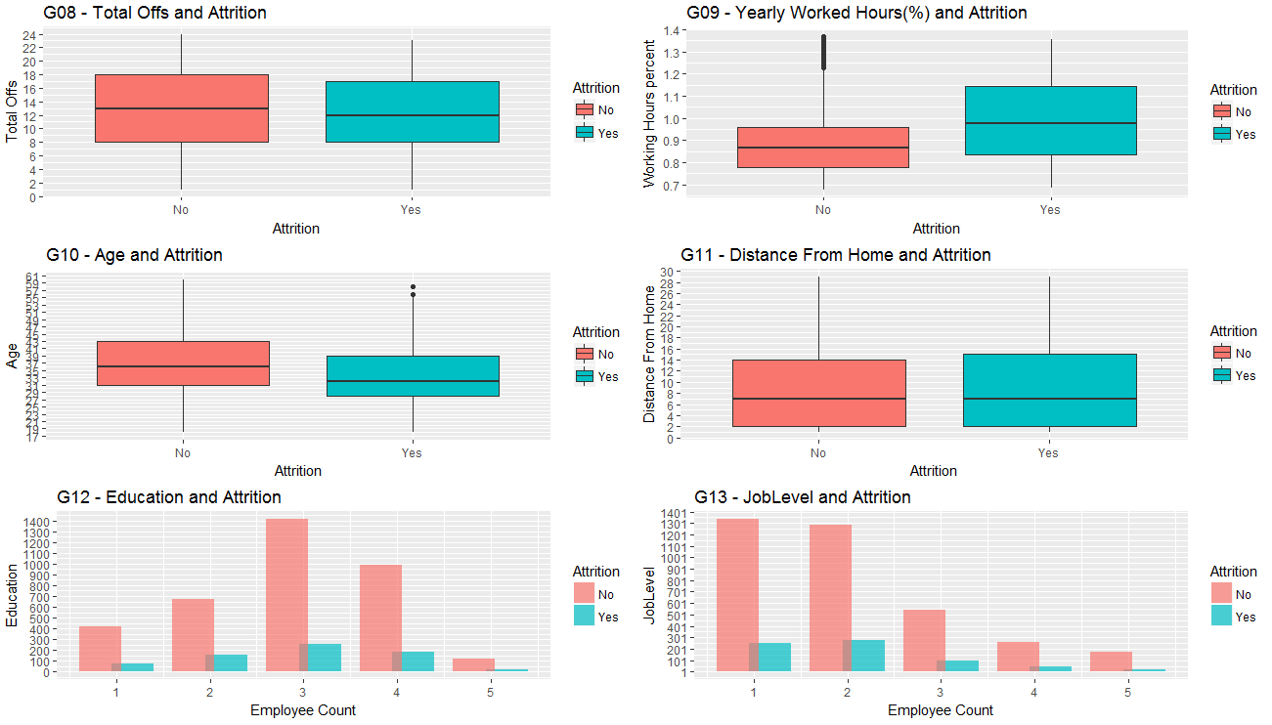
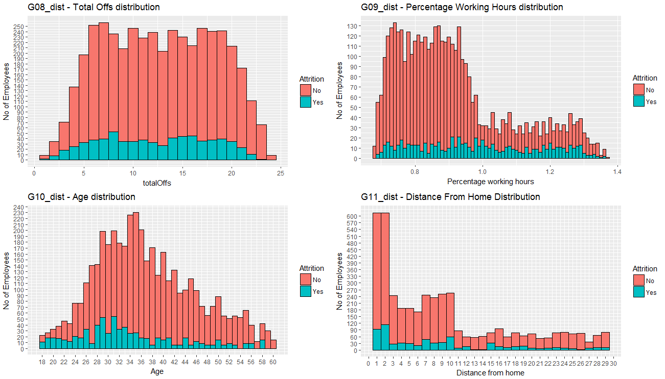
Univariate & Segmented Univariate – Numerical Features
Analysis (2/4)
Inference :
G(08) – TotalOffs & G(11) – DistanceFromHome
Attrition based on TotalOffs is has similar distribution across different number of offs. DistanceFromHome presents a mixed pattern about attrition.
G(10) – PercentageWorkingHours & G(10) - Age
Higher Percentage working clearly have higher attrition rate. Attrition among employees < 32 years is higher as compared to senior employees
Plot Methodology : Segmented Column plots
Aggregation : Various (as per plot)
Inference :
G(12)
Education (1 = BelowCollege, 5 = Doctor/PhD) has similar attrition rate across different levels (~ 15-18%)
G(13)
JobLevel, also has similar attrition rate across different levels.

Slide 10
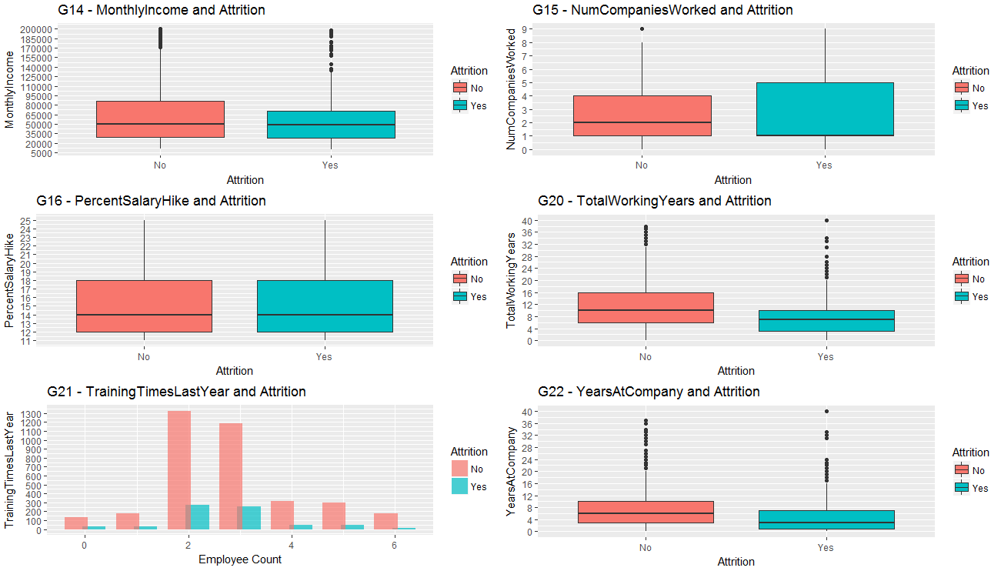
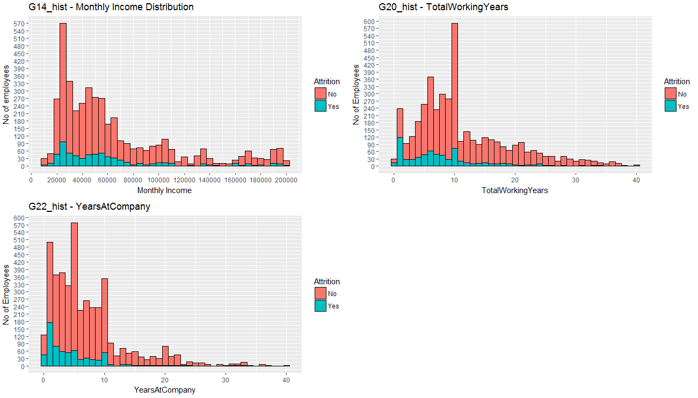
Univariate & Segmented Univariate – Numerical Features
Analysis (3/4)
Inference :
G(14) – MonthlyIncome
Lower monthly income has higher attrition rate, and the attrition rate reduces as the income increases.
G(20) – Total Experience & G(10) – Experience at XYZ Corp
Very high attrition rate for employees with just 1 year of experience (Freshers). Interestingly, people who have spend 2 years at XYZ Corp have a higher attrition rate.
Plot Methodology : Segmented Column plots
Aggregation : Various (as per plot)
Inference :
G(21) – Trainings in last year
Employees who has 0,2 & 3 training sessions in the last year have a higher attrition rate, rather than the ones who had 1 or more than 3 training sessions.
It seems no training or only some training is not appreciated by employees.

Slide 11
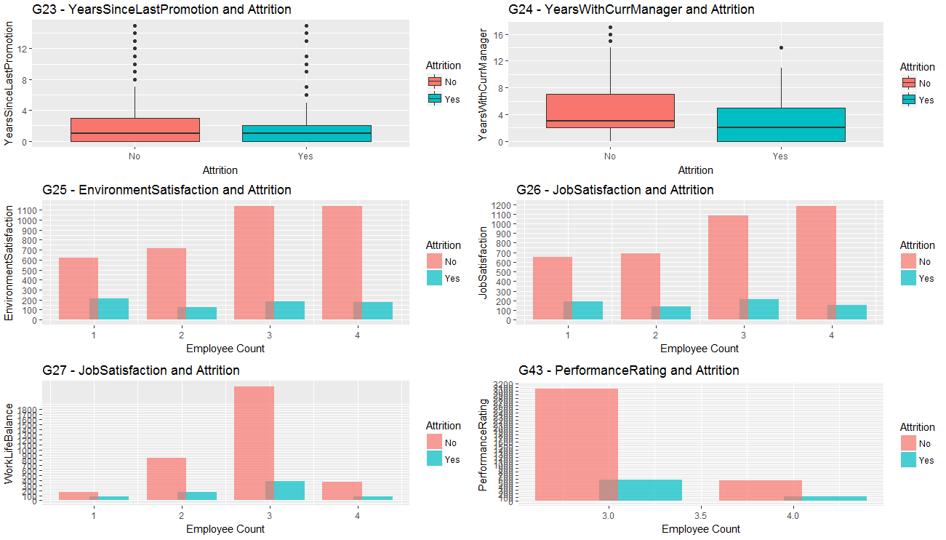
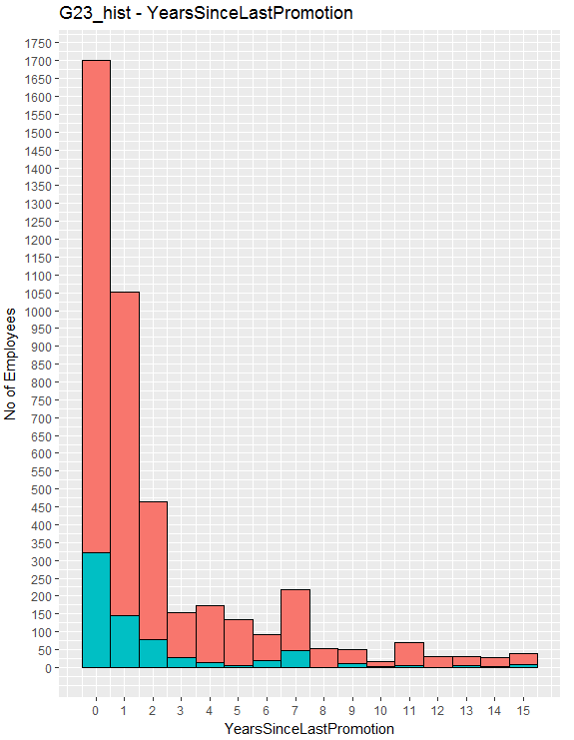
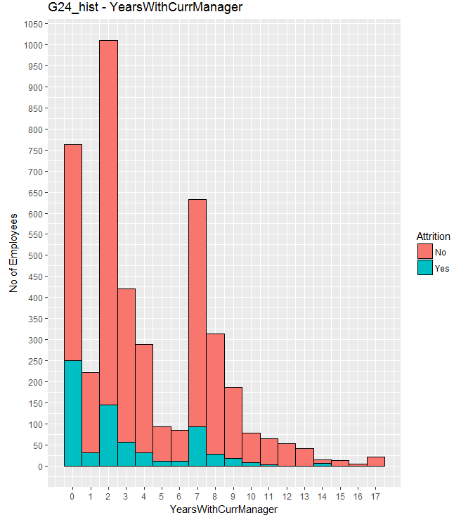
Univariate & Segmented Univariate – Numerical Features (Contd)
Analysis (4/4)
Inference :
G(25) – Environment Satisfaction
Attrition rate is very high (~ 25%) when Environment Satisfaction = 1. Attrition percentage reduces as environment satisfaction increases.
G(26) – Job Satisfaction
Job Satisfaction seem to be highly influential parameter. There is clear decrease in attrition as job satisfaction increases, which is an obvious reason.
G(23) – Yrs since Promotion G(24) – Yrs with Same Manager
7 years seems to be an important crucial year both for Promotion and same Manager perspective. Attrition rate seems to be high at 7th year for both categories.
Inference :
G(27) – Work Life Balance
Work life balance by obvious reasons, has high influence on attrition. Work life balance =1 equates to around 30% attrition.
G(27) – Performance Rating
Interestingly employees do not heave much importance to performance rating that managers give and hence attrition seems not effected.
Plot Methodology : Segmented Column plots
Aggregation : Various (as per plot)

Slide 12
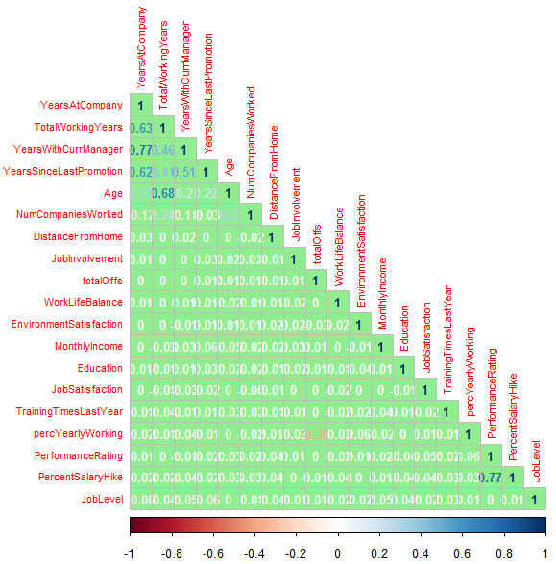
Bivariate Analysis - Correlation
between numerical variables
Fundamental of correlation in regression:
One of the objectives to identify significant variables which effect the business problem. Patterns in highly correlated variables will invariably be reflective of this significance.
Fundamentally, regression based models work on the principle of
Dependent = coefficient*independentVar + constant
Having co-related features defeat the purpose of independent variables
Having multiple correlated variables in the model, will undermine the detection and prediction capability of the model as it would require more number of iterations to reach the global minima during iterative regression approach.
HR Case Study Data set (merged)
There is no significant/strong correlation seen between any 2 variables. However, there are changes that correlation may exist between we evaluate 3 or more variables together. Such an analysis will be taken up during stepAIC evaluation.

Slide 13
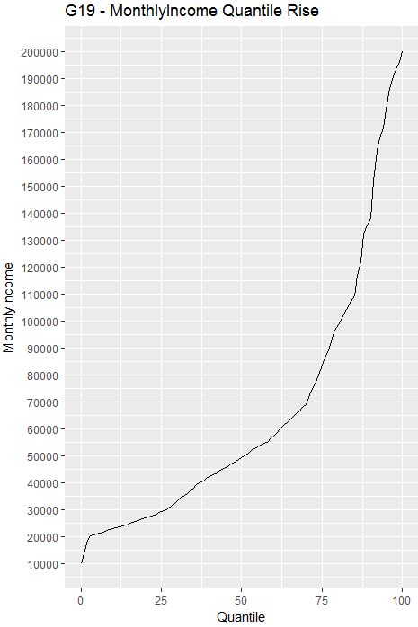
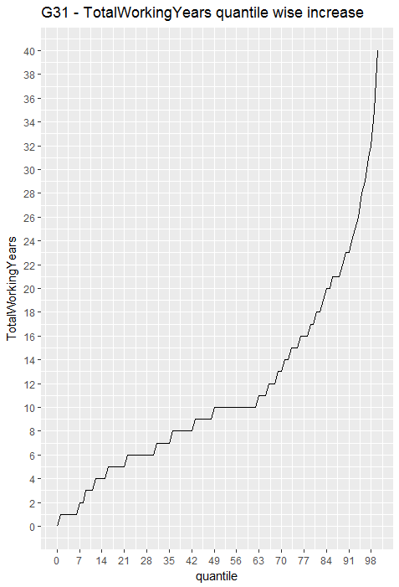
Outlier Treatment
Outlier Treatment rule employed
Various numerical features taken into consideration
MonthlyIncome
TotalWorkingYears
YearsAtCompany
YearsSinceLastPromotion
YearsWithCurrentManager
For every feature, a quantile & boxplot is taken for reference.
UpperEdge chosen for performing capping of outliers should result in effecting less 7-10% of complete dataset.
MonthlyIncome Outlier Treatment
Upper Edge | No. of rows | Perc of rows
Rs.1,70,000 | 282 | 6.5%
TotalWorkingYears Outlier Treatment
Upper Edge | No. of rows | Perc of rows
26 years | 247 | 5.7%

Slide 14
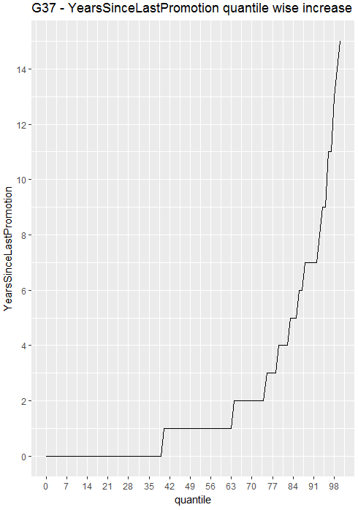
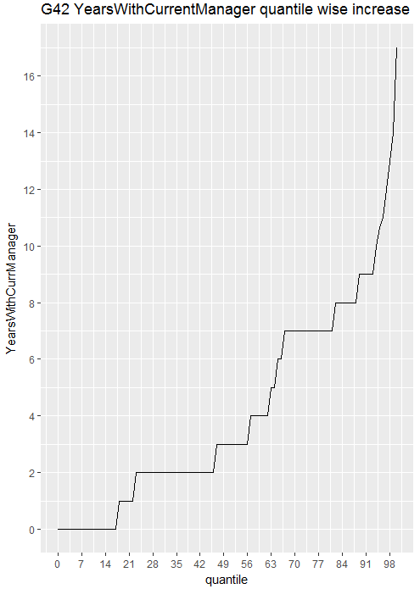
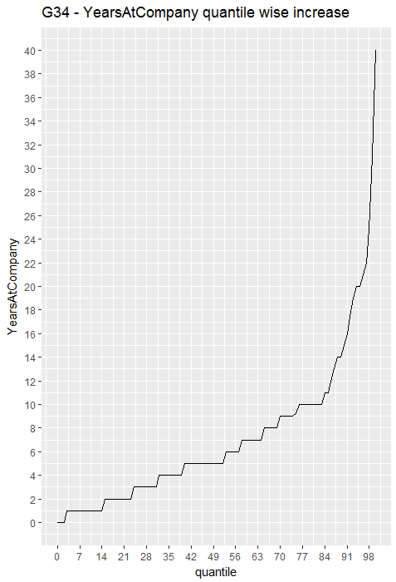
Outlier Treatment – (Contd)
YearsAtCompany Outlier Treatment
Upper Edge | No. of rows | Perc of rows
22 years | 111 | 2.57%
YearsSincePromotion Outlier Treatment
Upper Edge | No. of rows | Perc of rows
11 years | 126 | 2.92%
YearsWithCurrManger Outlier Treatment
Upper Edge | No. of rows | Perc of rows
11 years | 151 | 3.5%

Slide 15
Model Building
Information related to data used for model building
Number of numerical columns | 19
Number of categorical columns used | 7 (Including Gender)
Columns for model.matrix functionality | 6 (excluding Gender)
No. of columns made after model.matrix | 22
Final Independent column (X) | Numerical + model.matrix + Gender + 1 information column (employee ID) 19 + 22 + 1 + 1 = 42 columns
Dependent Column | “Attrition”
Final Dimensions of data frame used for modeling = 4308 X 44 (train = 70% of 4308 & test = 30% 4308)
Features for model building
totalOffs | percYearlyWorking | Age
DistanceFromHome | Education | JobLevel
MonthlyIncome | NumCompaniesWorked | PercentSalaryHike
TotalWorkingYears | TrainingTimesLastYear | YearsAtCompany
YearsSinceLastPromotion | YearsWithCurrManager | EnvironmentSatisfaction
JobSatisfaction | WorkLifeBalance | JobInvolvement
PerformanceRating | Gender | BusinessTravel.xTravel_Frequently
BusinessTravel.xTravel_Rarely | Department.xResearch...Development | Department.xSales
EducationField.xLife.Sciences | EducationField.xMarketing | EducationField.xMedical
EducationField.xOther | EducationField.xTechnical.Degree | JobRole.xHuman.Resources
JobRole.xLaboratory.Technician | JobRole.xManager | JobRole.xManufacturing.Director
JobRole.xResearch.Director | JobRole.xResearch.Scientist | JobRole.xSales.Executive
JobRole.xSales.Representative | MaritalStatus.xMarried | MaritalStatus.xSingle
StockOptionLevel.x1 | StockOptionLevel.x2 | StockOptionLevel.x3
Operation | AIC value
Model 1 (42 independent + 1 dependent) | 2118.4
StepAIC execution Number of columns suggested : 25 | 2092.36
Model 13 (Final Model) Number of significant columns : 13 (excluding intercept) | 2117.4
Note : Detailed information about p-values, VIF and AIC added as Appendix with R code

Slide 16
Significant Features
P-values and coefficients
Feature | Coefficient | P-value | Significance Stars
(Intercept) | -2.6219 | 2.00E-16 | ***
percYearlyWorking | 0.58747 | 2.00E-16 | ***
Age | -0.26054 | 0.00092 | ***
NumCompaniesWorked | 0.36017 | 3.56E-10 | ***
TotalWorkingYears | -0.64254 | 7.79E-10 | ***
TrainingTimesLastYear | -0.20913 | 0.00028 | ***
YearsSinceLastPromotion | 0.62684 | 6.19E-13 | ***
Feature | Coefficient | P-value | Significance Stars
YearsWithCurrManager | -0.5809 | 8.29E-10 | ***
EnvironmentSatisfaction | -0.38163 | 6.03E-12 | ***
JobSatisfaction | -0.39377 | 3.16E-12 | ***
WorkLifeBalance | -0.24788 | 5.64E-06 | ***
BusinessTravel.xTravel_Frequently | 0.78395 | 1.66E-09 | ***
JobRole.xManufacturing.Director | -0.92506 | 3.21E-05 | ***
MaritalStatus.xSingle | 1.03141 | 2.00E-16 | ***
Note: A logical understanding of the above co-efficient and their impact on attrition is given at the end of the presentation

Slide 17
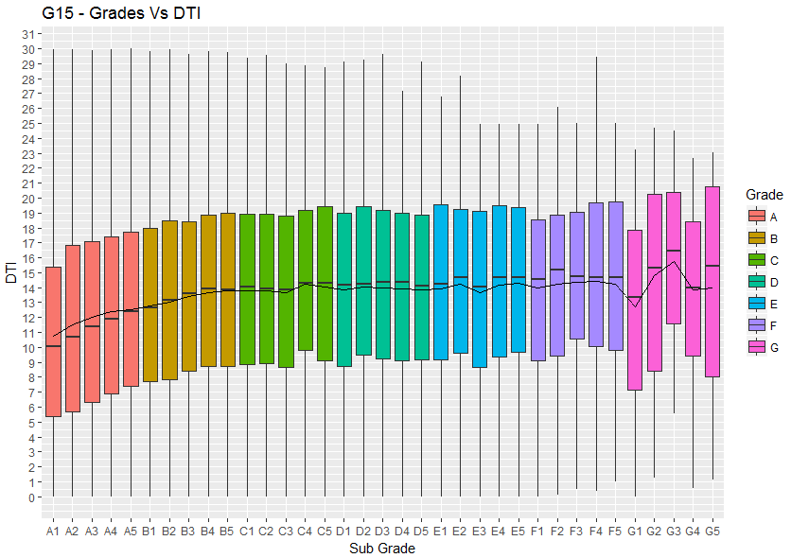
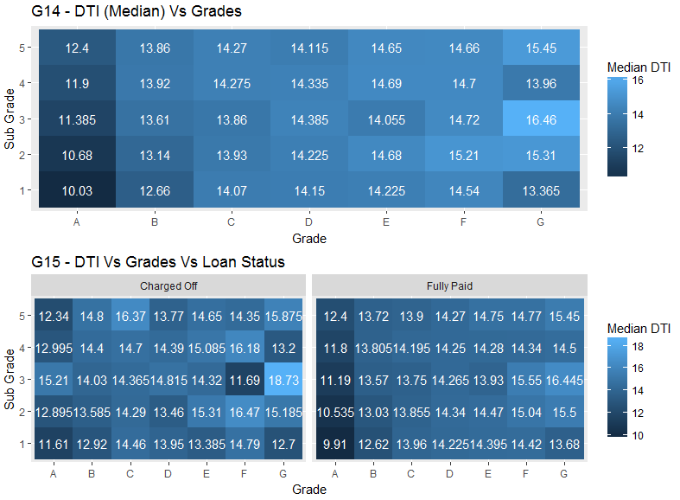
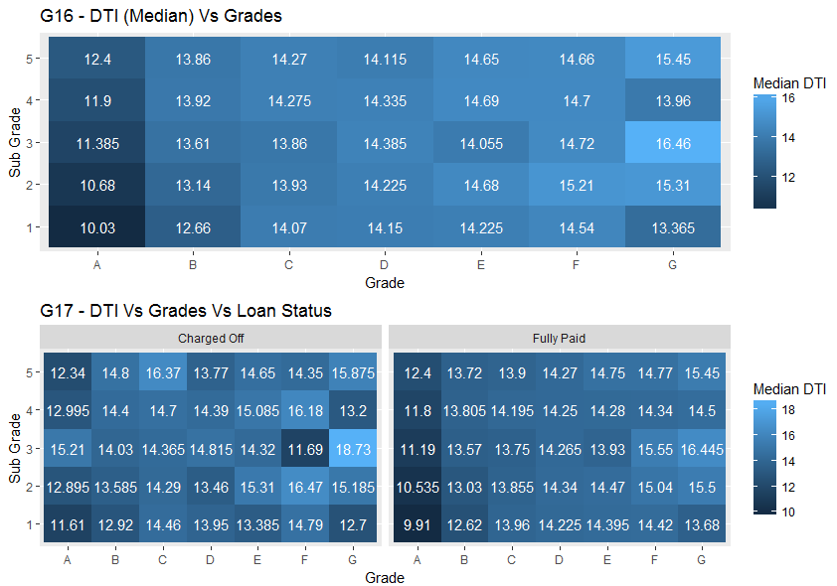
Bivariate Analysis (Contd.)
SubGrade “G3” Problem:
DTI Value (Median) for SubGrade G3 seems to be an outlier in the whole distribution. This aspect can be seen in Charged Off Loans as well as Full Paid Loans.
Loans given in G3 Grade should be looked in to carefully for probable “Charged Off Problems”
Plot Methodology : Tile Plot for DTI(Median)
Aggregation : Grade, SubGrade &
LoanStatus
Plot Methodology : BoxPlot of DTI Vs SubGrade
Aggregation : SubGrade
Inference :
G(15,G16,G17)
Grade/SubGrade Vs DTI
DTI is the ratio calculated using the borrower’s total monthly debt payments on the total debt obligations, divided by the borrower’s self-reported monthly income.
From Tile Plot is clear that as the Sub Grade increases (A1 – G5) the DTI value is also increasing.
Conclusion:
DTI seems to be related to SubGrade hence we can take just Subgrade as a reference variable.

Slide 18
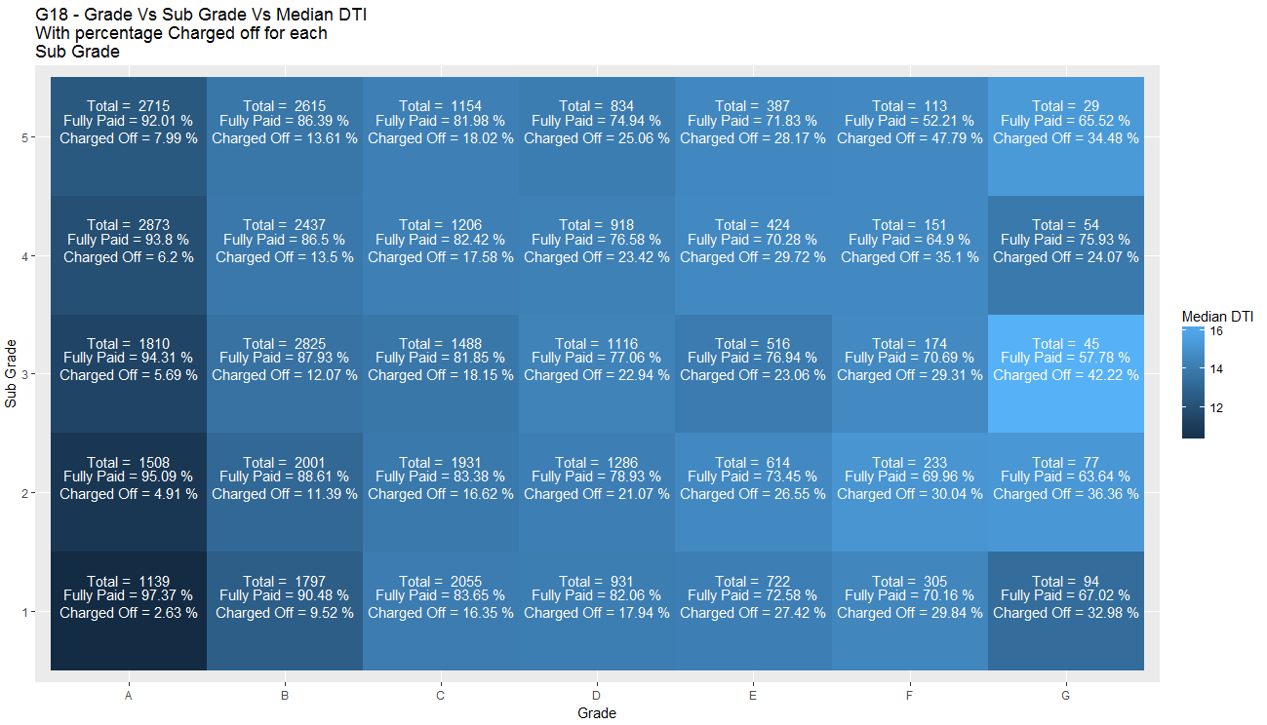
Bivariate Analysis (Contd.)
SubGrade “G3” Problem Description
Inference :
G(18)
SubGrade “G3” Issue
There seems to be an issue with the loans being issued under SubGrade = “G3”
DTI value for loans issued under G3 seems to be exceptionally high, and does not follow an even pattern like other grades.
Percentage “Charged Off” loans under this category are high as well.
The banking institution should check the procedures being followed for giving away loans in SubGrade = “G3” category.
Plot Methodology : Tile Plot with median of DTI
Aggregation : Grade, SubGrade Vs DTI(Median)

Slide 19
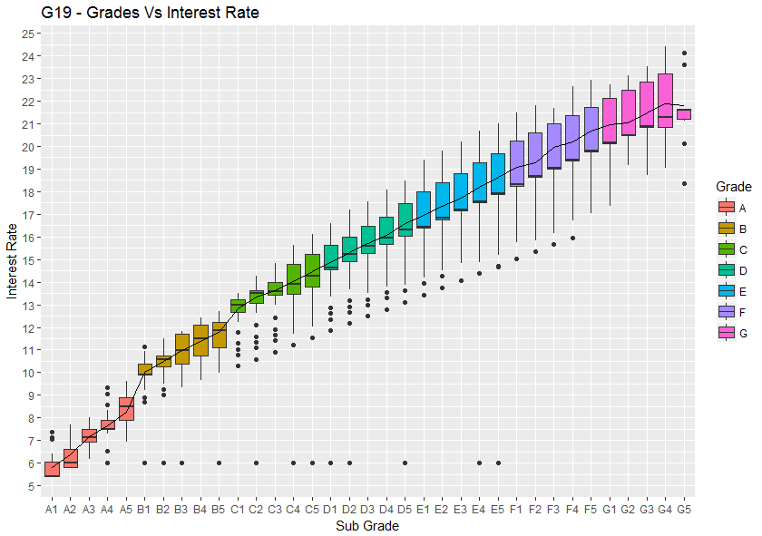
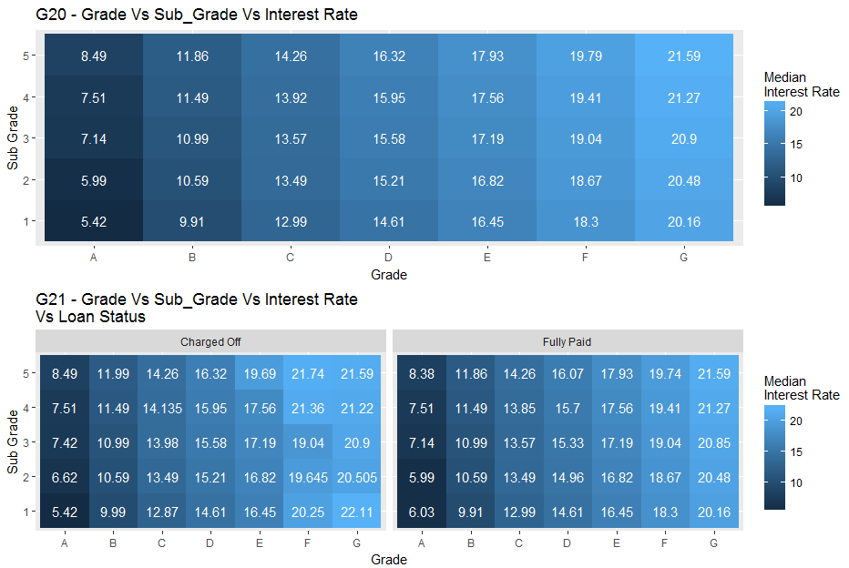
Bivariate Analysis (Contd.)
Plot Methodology : Boxplot Interest Rate against SubGrade
Aggregation : Grade, SubGrade Vs Interest Rate
Plot Methodology : Tile Plot with median of Interest Rate
Aggregation : Grade, SubGrade Vs Interest Rate
Inference :
G(19,20,21)
Grade/SubGrade Vs Interest Rate
Loan interest rate shows a clear co-relation with subgrade feature.
Conclusion:
Since we are considering grade as an influencing variable, therefore, interest rate would be considered invariably.
Hence we can leave away interest rate from being considered as an influencing variable.

Slide 20
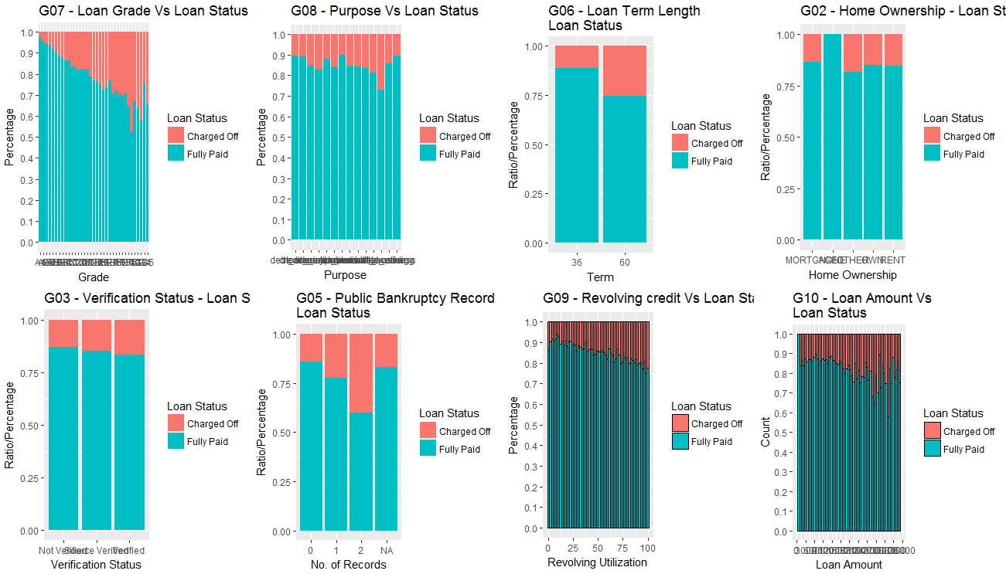
Conclusion – EDA
Primary Influential Variables for Loan Status Analysis
Inference :
Based on EDA analysis, following variables can be said to be influencing the loan status to large extent.
Based on these parameters a predictive model can be created which will be able to predict the probability metrics as to whether currently running loans may end up as “Charged Off” or “Fully Paid”
Note: Below list has been created on the basis of level of influence.
1. sub_grade - G07
2. purpose - G08
3. term - G06
4. home_ownership - G02
5. verification_status - G03
6. public bankruptcy records - G05
7. revol_util_range - G09
8. loan_amnt_range - G10

Slide 21
Predictive Analysis
Logical Assumption taken for Predictive Analysis and Methodology
Explanation :
Based on EDA shown above, we have zeroed down on 8 critical variables which effect the loan_status. The analysis below tries to predict the loans which are currently running, with a certain level of accuracy whether a loan might end up as "Charged Off" or "Fully Paid"
Description of Analysis
Let us say there is a borrower who has following credentials
subGrade = G3
home_ownership = OWN
Verification status = Not Verified …. So and so forth.
Analysis methodology
Step 1) We take up every such row which needs to be checked
Step 2) We take up the complete known data set where where loan_status is known
Step 3) We start by comparing looking for row/rows which match all the 8 conditions mentioned above
Step 4) There are possibilities that we might get to only 3 out of 8 conditions only, but that is not a problem
Step 5) Once we get to the closest matching conditions (whether 3,4,5...), we calculate the ratios
Step 6) We take the ratio = #Number of Charged Off Loans/#Number of total loans given * (level/9)
Step 7) Step (6) is the probability of borrower defaulting the loan
Based on above process we are able to get following type of results.
Probability that the member_id will result in a “Charged Off” loan or “Fully Paid” loan. Higher the ratio, higher is probability to default.

Slide 22
Cross Validation Of Predictive Analysis
& Reduction of Loss To Bank
Explanation :
Based on the explanation provided previously, we have to decide on a “CutOff” probability so that
Before the cutoff probability, all borrowers will be classified as “Safe/Good Customers” and their loans are predicted to be closed as “Fully Paid”
Above the cutoff Probability, borrowers will be classified as “UnSafe/Bad Customers” and their loans are predicted to be closed as “Charged Off”
How to decide the CutOff Probability
We execute the same algorithm discussed above on existing data set where “Loan_Status” is known.
By performing above operation on multiple random sets of known data, we will get following results
Prediction Accuracy
For loans predicted as “Charged Off” who were actually “Fully Paid”, the loss is
Projected Business Loss of Good Customer
For Loans predicted as “Fully Paid” who were actually “Charged Off”, the loss is
Projected Business Loss to Defaulters
We have to reach a “BALANCING VALUE”, which minimizes both the losses. The above analysis generates a data like this
Prediction Accuracy
Projected Business Loss (in different cases)

Slide 23
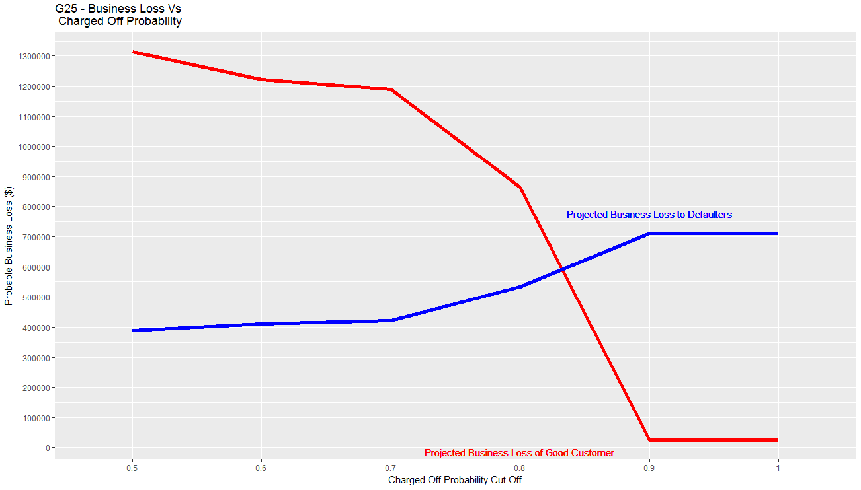
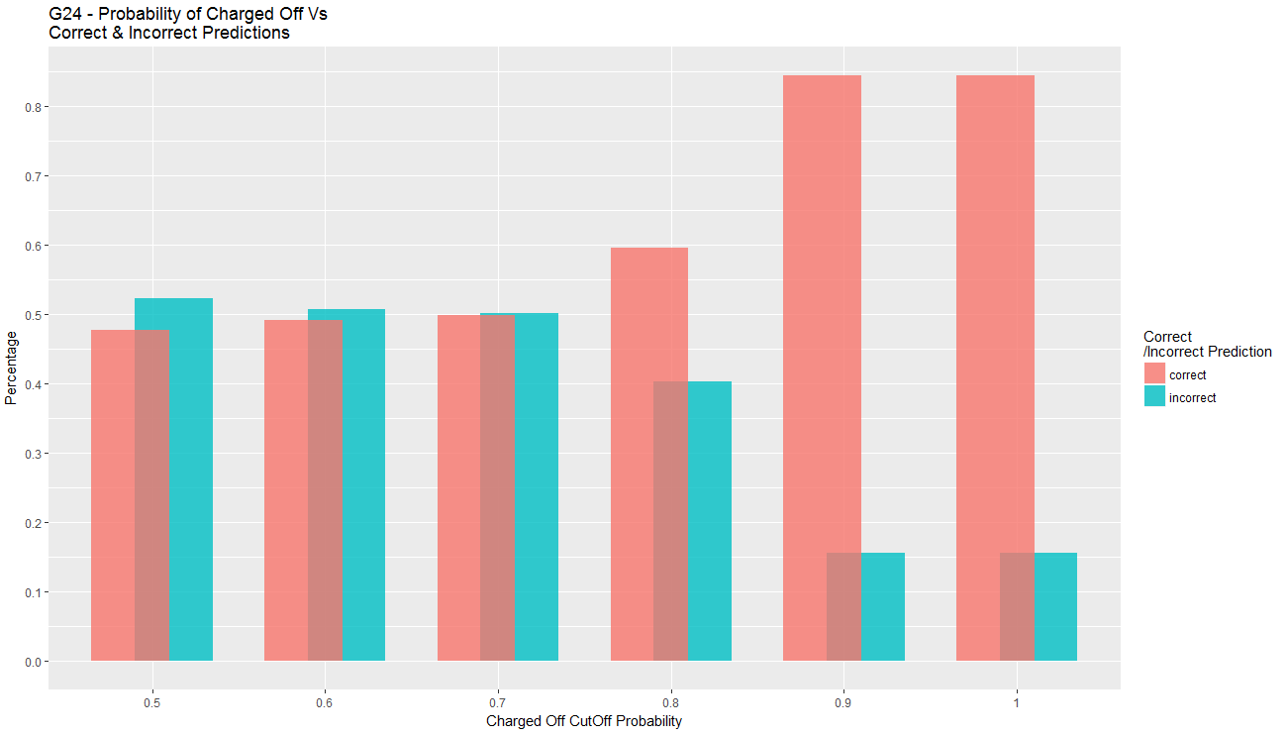
Predictive Analytics Results
(Prediction Accuracy)
Inference :
For maximizing prediction accuracy, following can be chosen
CutOff Probability for Charged Off categorization = 1
But choosing the cutoff = 1 does not reduce the loss.
Inference :
Above graph shows the movement of losses incurred by the bank by choosing a specific “cutoff” value.
It can be seen that lower cutoff value, increases the Good Customer Business loss but reduces loss to defaulters
Similarly, higher cutoff value, increases the probable loss to defaulters, but reduces the Good Customer business loss.
Hence, a balanced cutoff Value chosen ~ 0.825

Slide 24
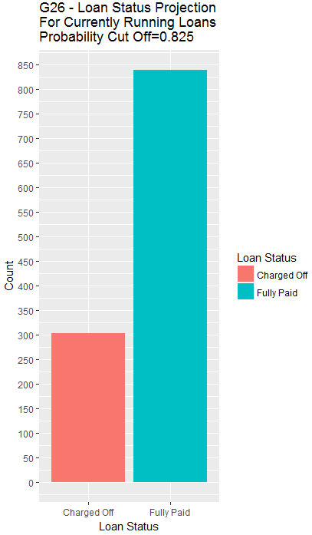

Prediction for Currently Running Loans
Based on the Predictive Analysis above
Out of total Loans with loan_status == Current
Total Loans = 1140 Loans
302 Loans – Charged Off (Projected)
838 Loans – Fully Paid (Projected)
Above Prediction has been made through an CutOff probability value = 0.825
The above prediction has been done to reduce the probable loss incurred by the bank.

